Slide 1
Chapter 19: Recovery System

Slide 2
Outline
Failure Classification
Storage Structure
Recovery and Atomicity
Log-Based Recovery
Shadow paging

Slide 3
Failure Classification
Transaction failure :
Logical errors: transaction cannot complete due to some internal error condition (wrong input, overflow, data not found)
System errors: the database system must terminate an active transaction due to an error condition (e.g., deadlock)
System crash: a power failure or other hardware or software failure causes the system to crash.
Fail-stop assumption: non-volatile storage contents are assumed to not be corrupted by system crash
Database systems have numerous integrity checks to prevent corruption of disk data
Disk failure: a head crash or similar disk failure destroys all or part of disk storage
Destruction is assumed to be detectable: disk drives use checksums to detect failures

Slide 4
Recovery Algorithms
Suppose transaction T_{i} transfers $50 from account A to account B
Two updates: subtract 50 from A and add 50 to B
Transaction T_{i} requires updates to A and B to be output to the database.
A failure may occur after one of these modifications have been made but before both of them are made.
Modifying the database without ensuring that the transaction will commit may leave the database in an inconsistent state
Not modifying the database may result in lost updates if failure occurs just after transaction commits
Recovery algorithms have two parts
Actions taken during normal transaction processing to ensure enough information exists to recover from failures
Actions taken after a failure to recover the database contents to a state that ensures atomicity, consistency and durability

Slide 5
Storage Structure
Volatile storage:
Does not survive system crashes
Examples: main memory, cache memory
Nonvolatile storage:
Survives system crashes
Examples: disk, tape, flash memory, non-volatile RAM
But may still fail, losing data
Stable storage:
A mythical form of storage that survives all failures
Approximated by maintaining multiple copies on distinct nonvolatile media
RAID

Slide 6
Stable-Storage Implementation
Maintain multiple copies of each block on separate disks
copies can be at remote sites to protect against disasters such as fire or flooding.
Failure during data transfer can still result in inconsistent copies: Block transfer can result in
Successful completion
Partial failure: destination block has incorrect information
Total failure: destination block was never updated
Protecting storage media from failure during data transfer (one solution):
Execute output operation as follows (assuming two copies of each block):
Write the information onto the first physical block.
When the first write successfully completes, write the same information onto the second physical block.
The output is completed only after the second write successfully completes.
Notes:
6

Slide 7
Protecting storage media from failure (Cont.)
Copies of a block may differ due to failure during output operation.
To recover from failure:
1. First find inconsistent blocks:
Expensive solution: Compare the two copies of every disk block.
Better solution:
Record in-progress disk writes on non-volatile storage (Flash, Non-volatile RAM or special area of disk).
Use this information during recovery to find blocks that may be inconsistent, and only compare copies of these.
Used in hardware RAID systems
2. If either copy of an inconsistent block is detected to have an error
(bad checksum), overwrite it by the other copy. If both have no error,
but are different, overwrite the second block by the first block.
Notes:
7

Slide 8
Data Access
Physical blocks are those blocks residing on the disk.
Buffer blocks are the blocks residing temporarily in main memory.
Block movements between disk and main memory are initiated through the following two operations:
input (B) transfers the physical block B to main memory.
output (B) transfers the buffer block B to the disk, and replaces the appropriate physical block there.
We assume, for simplicity, that each data item fits in, and is stored inside, a single block.

Slide 9
Data Access (Cont.)
Each transaction T_{i} has its private work-area in which local copies of all data items accessed and updated by it are kept.
T_{i} 's local copy of a data item X is called x_{i}.
Transferring data items between system buffer blocks and its private work-area done by:
read(X) assigns the value of data item X to the local variable x_{i}.
write(X) assigns the value of local variable x_{i} to data item {X} in the buffer block.
Transactions
Must perform read(X) before accessing X for the first time (subsequent reads can be from local copy)
write(X) can be executed at any time before the transaction commits

Slide 10
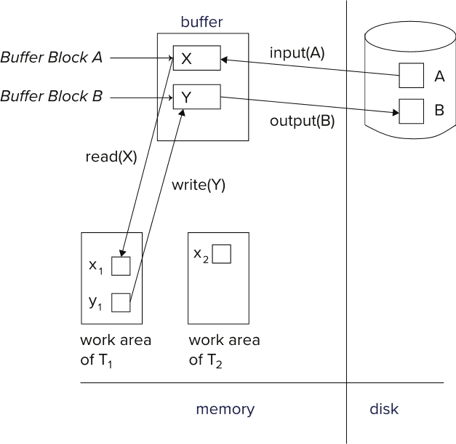
Example of Data Access

Slide 11
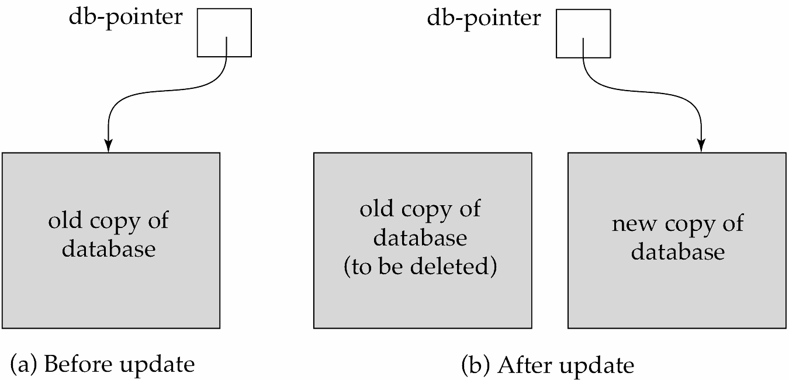
Recovery and Atomicity
To ensure atomicity despite failures, we first output information describing the modifications to stable storage without modifying the database itself.
We study log-based recovery mechanisms in detail
We first present key concepts
And then present the actual recovery algorithm
Less used alternative: shadow-copy and shadow-paging (brief details in book)
shadow-copy

Slide 12
Log-Based Recovery
A log is a sequence of log records. The records keep information about update activities on the database.
The log is kept on stable storage
When transaction T_{i} starts, it registers itself by writing a
<T_{i} start> log record
Before T_{i} executes write(X), a log record
<T_{i}, X, V₁, V₂>
is written, where V₁ is the value of X before the write (the old
value), and V₂ is the value to be written to X (the new value).
When T_{i} finishes it last statement, the log record <T_{i} commit> is written.
Two approaches using logs
Immediate database modification
Deferred database modification.

Slide 13
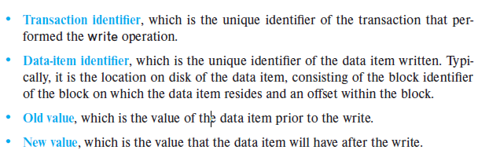
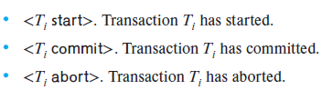
Cont..

Slide 14
Immediate Database Modification
The immediate-modification scheme allows updates of an uncommitted transaction to be made to the buffer, or the disk itself, before the transaction commits
Update log record must be written before database item is written
We assume that the log record is output directly to stable storage
(Will see later that how to postpone log record output to some extent)
Output of updated blocks to disk can take place at any time before or after transaction commit
Order in which blocks are output can be different from the order in which they are written.
The deferred-modification scheme performs updates to buffer/disk only at the time of transaction commit
Simplifies some aspects of recovery
But has overhead of storing local copy

Slide 15
Transaction Commit
A transaction is said to have committed when its commit log record is output to stable storage
All previous log records of the transaction must have been output already
Writes performed by a transaction may still be in the buffer when the transaction commits, and may be output later

Slide 16
Immediate Database Modification Example
Log Write Output
<T₀ start>
<T₀, A, 1000, 950>
<T₀, B, 2000, 2050>
A = 950
B = 2050
<T₀ commit>
<T₁ start>
<T₁, C, 700, 600>
C = 600
B_{B} , B_{C}
<T₁ commit>
B_{A}
Note: B_{X} denotes block containing X.
B_{C} output before T₁ commits
B_{A} output after T₀ commits

Slide 17
Concurrency Control and Recovery
With concurrent transactions, all transactions share a single disk buffer and a single log
A buffer block can have data items updated by one or more transactions
We assume that if a transaction T_{i} has modified an item, no other transaction can modify the same item until T_{i} has committed or aborted
i.e., the updates of uncommitted transactions should not be visible to other transactions
Otherwise, how to perform undo if T₁ updates A, then T₂ updates A and commits, and finally T₁ has to abort?
Can be ensured by obtaining exclusive locks on updated items and holding the locks till end of transaction (strict two-phase locking)
Log records of different transactions may be interspersed in the log.

Slide 18
Undo and Redo Operations
Undo and Redo of Transactions
undo(T_{i}) -- restores the value of all data items updated by T_{i} to their old values, going backwards from the last log record for T_{i}
Each time a data item X is restored to its old value V a special log record <T_{i} , X, V> is written out
When undo of a transaction is complete, a log record <T_{i} abort> is written out.
redo(T_{i}) -- sets the value of all data items updated by T_{i} to the new values, going forward from the first log record for T_{i}
No logging is done in this case

Slide 19
Recovering from Failure
When recovering after failure:
Transaction T_{i} needs to be undone if the log
Contains the record <T_{i} start>,
But does not contain either the record <T_{i} commit> or <T_{i} abort>.
Transaction T_{i} needs to be redone if the log
Contains the records <T_{i} start>
And contains the record <T_{i} commit> or <T_{i} abort>

Slide 20
Recovering from Failure (Cont.)
Suppose that transaction T_{i} was undone earlier and the <T_{i} abort> record was written to the log, and then a failure occurs,
On recovery from failure transaction T_{i} is redone
Such a redo redoes all the original actions of transaction T_{i} including the steps that restored old values
Known as repeating history
Seems wasteful, but simplifies recovery greatly

Slide 21
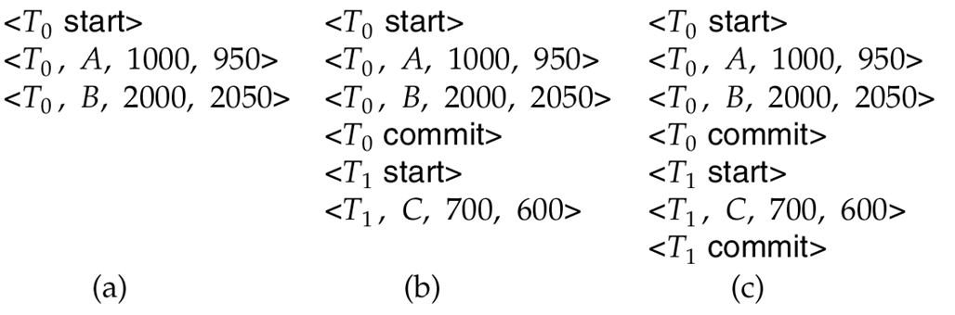
Immediate DB Modification Recovery Example
Below we show the log as it appears at three instances of time.
Recovery actions in each case above are:
(a) undo (T₀): B is restored to 2000 and A to 1000, and log records <T₀, B, 2000>, <T₀, A, 1000>, <T₀, abort> are written out
(b) redo (T₀) and undo (T₁): A and B are set to 950 and 2050 and C is restored to 700. Log records <T₁, C, 700>, <T₁, abort> are written out.
(c) redo (T₀) and redo (T₁): A and B are set to 950 and 2050
respectively. Then C is set to 600

Slide 22
Checkpoints
Redoing/undoing all transactions recorded in the log can be very slow
Processing the entire log is time-consuming if the system has run for a long time
We might unnecessarily redo transactions which have already output their updates to the database.
Streamline recovery procedure by periodically performing checkpointing
1. Output all log records currently residing in main memory onto stable
storage.
2. Output all modified buffer blocks to the disk.
3. Write a log record < checkpoint L> onto stable storage where L is a
list of all transactions active at the time of checkpoint.
4. All updates are stopped while doing checkpointing

Slide 23
Checkpoints (Cont.)
During recovery we need to consider only the most recent transaction T_{i} that started before the checkpoint, and transactions that started after T_{i}.
Scan backwards from end of log to find the most recent <checkpoint L> record
Only transactions that are in L or started after the checkpoint need to be redone or undone
Transactions that committed or aborted before the checkpoint already have all their updates output to stable storage.
Some earlier part of the log may be needed for undo operations
Continue scanning backwards till a record <T_{i} start> is found for every transaction T_{i} in L.
Parts of log prior to earliest <T_{i} start> record above are not needed for recovery, and can be erased whenever desired.

Slide 24
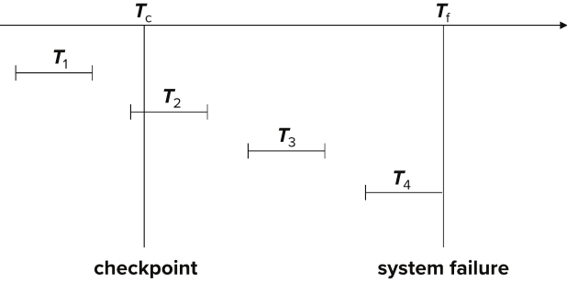
Example of Checkpoints
T₁ can be ignored (updates already output to disk due to checkpoint)
T₂ and T₃ redone.
T₄ undone
T₁ can be ignored (updates already output to disk due to checkpoint)
T₂ and T₃ redone.
T₄ undone

Slide 25
Recovery Algorithm
Logging (during normal operation):
<T_{i} start> at transaction start
<T_{i}, X_{j}, V₁, V₂> for each update, and
<T_{i} commit> at transaction end
Transaction rollback (during normal operation)
Let T_{i} be the transaction to be rolled back
Scan log backwards from the end, and for each log record of T_{i} of the form <T_{i}, X_{j}, V₁, V₂>
Perform the undo by writing V₁ to X_{j},
Write a log record <T_{i} , X_{j}, V₁>
such log records are called compensation log records
Once the record <T_{i} start> is found stop the scan and write the log record <T_{i} abort>

Slide 26
Recovery Algorithm (Cont.)
Recovery from failure: Two phases
Redo phase: replay updates of all transactions, whether they committed, aborted, or are incomplete
Undo phase: undo all incomplete transactions
Redo phase:
1. Find last <checkpoint L> record, and set undo-list to L.
2. Scan forward from above <checkpoint L> record
Whenever a record <T_{i}, X_{j}, V₁, V₂> or <T_{i}, X_{j}, V₂> is found, redo it by writing V₂ to X_{j}
Whenever a log record <T_{i} start> is found, add T_{i} to undo-list
Whenever a log record <T_{i} commit> or <T_{i} abort> is found, remove T_{i} from undo-list

Slide 27
Recovery Algorithm (Cont.)
Undo phase:
1. Scan log backwards from end
Whenever a log record <T_{i}, X_{j}, V₁, V₂> is found where T_{i} is in undo-list perform same actions as for transaction rollback:
perform undo by writing V₁ to X_{j}.
write a log record <T_{i} , X_{j}, V₁>
Whenever a log record <T_{i} start> is found where T_{i} is in undo-list,
Write a log record <T_{i} abort>
Remove T_{i} from undo-list
Stop when undo-list is empty
1. i.e., <T_{i} start> has been found for every transaction in undo-list
After undo phase completes, normal transaction processing can commence

Slide 28
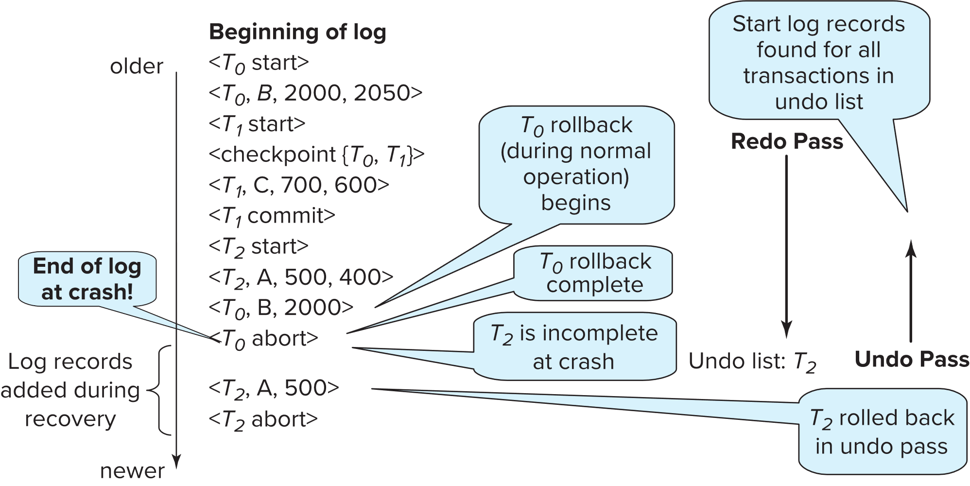
Example of Recovery

Slide 29
Log Record Buffering
Log record buffering: log records are buffered in main memory, instead of being output directly to stable storage.
Log records are output to stable storage when a block of log records in the buffer is full, or a log force operation is executed.
Log force is performed to commit a transaction by forcing all its log records (including the commit record) to stable storage.
Several log records can thus be output using a single output operation, reducing the I/O cost.

Slide 30
Log Record Buffering (Cont.)
The rules below must be followed if log records are buffered:
Log records are output to stable storage in the order in which they are created.
Transaction T_{i} enters the commit state only when the log record <T_{i} commit> has been output to stable storage.
Before a block of data in main memory is output to the database, all log records pertaining to data in that block must have been output to stable storage.
This rule is called the write-ahead logging or WAL rule
Strictly speaking, WAL only requires undo information to be output

Slide 31
Database Buffering
Database maintains an in-memory buffer of data blocks
When a new block is needed, if buffer is full an existing block needs to be removed from buffer
If the block chosen for removal has been updated, it must be output to disk
The recovery algorithm supports the no-force policy: i.e., updated blocks need not be written to disk when transaction commits
force policy: requires updated blocks to be written at commit
More expensive commit
The recovery algorithm supports the steal policy: i.e., blocks containing updates of uncommitted transactions can be written to disk, even before the transaction commits

Slide 32
Database Buffering (Cont.)
If a block with uncommitted updates is output to disk, log records with undo information for the updates are output to the log on stable storage first
(Write ahead logging)
No updates should be in progress on a block when it is output to disk. Can be ensured as follows.
Before writing a data item, transaction acquires exclusive lock on block containing the data item
Lock can be released once the write is completed.
Such locks held for short duration are called latches.
To output a block to disk
1. First acquire an exclusive latch on the block
Ensures no update can be in progress on the block
2. Then perform a log flush
3. Then output the block to disk
4. Finally release the latch on the block
Notes:
32

Slide 33
Buffer Management (Cont.)
Database buffer can be implemented either
In an area of real main-memory reserved for the database, or
In virtual memory
Implementing buffer in reserved main-memory has drawbacks:
Memory is partitioned before-hand between database buffer and applications, limiting flexibility.
Needs may change, and although operating system knows best how memory should be divided up at any time, it cannot change the partitioning of memory.

Slide 34
Buffer Management (Cont.)
Database buffers are generally implemented in virtual memory in spite of some drawbacks:
When operating system needs to evict a page that has been modified, the page is written to swap space on disk.
When database decides to write buffer page to disk, buffer page may be in swap space, and may have to be read from swap space on disk and output to the database on disk, resulting in extra I/O!
Known as dual paging problem.
Ideally when OS needs to evict a page from the buffer, it should pass control to database, which in turn should
Output the page to database instead of to swap space (making sure to output log records first), if it is modified
Release the page from the buffer, for the OS to use
Dual paging can thus be avoided, but common operating systems do not support such functionality.

Slide 35
Shadow Paging
Shadow paging is an alternative to log-based recovery; this scheme is useful if transactions execute serially
Idea: maintain two page tables during the lifetime of a transaction –the current page table, and the shadow page table
Store the shadow page table in nonvolatile storage, such that state of the database prior to transaction execution may be recovered.
Shadow page table is never modified during execution
To start with, both the page tables are identical. Only current page table is used for data item accesses during execution of the transaction.
Whenever any page is about to be written for the first time
A copy of this page is made onto an unused page.
The current page table is then made to point to the copy
The update is performed on the copy

Slide 36
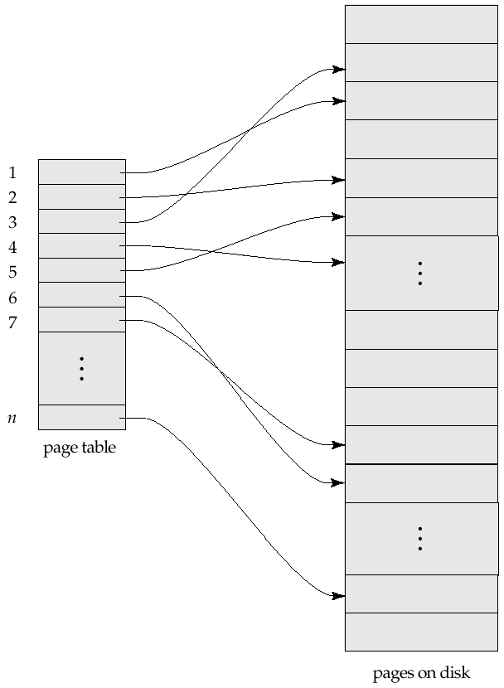
Sample Page Table

Slide 37
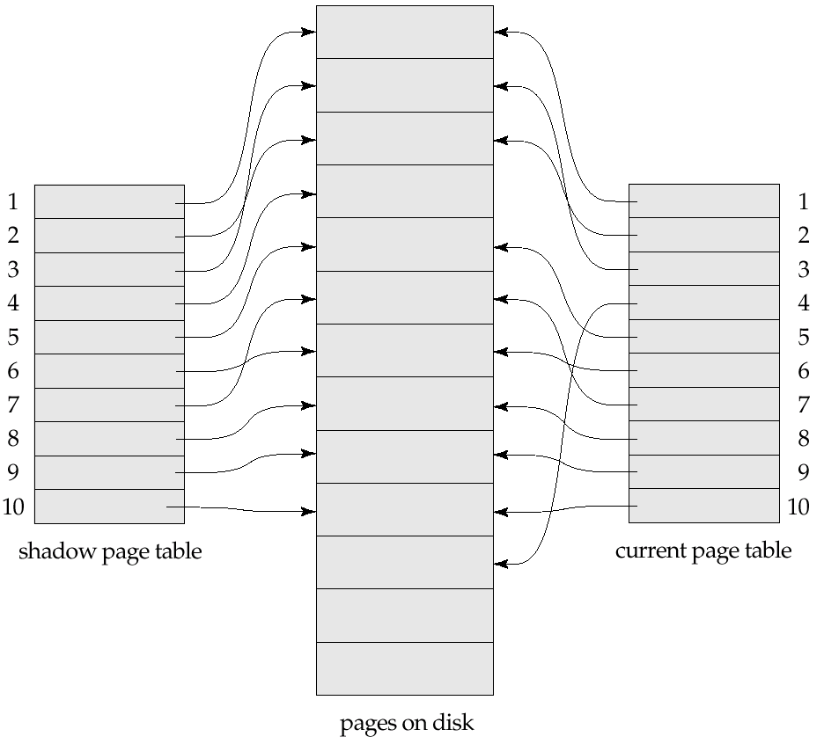
Example of Shadow Paging
Shadow and current page tables after write to page 4

Slide 38
Shadow Paging (Cont.)
To commit a transaction :
1. Flush all modified pages in main memory to disk
2. Output current page table to disk
3. Make the current page table the new shadow page table, as follows:
keep a pointer to the shadow page table at a fixed (known) location on disk.
to make the current page table the new shadow page table, simply update the pointer to point to current page table on disk
Once pointer to shadow page table has been written, transaction is committed.
No recovery is needed after a crash — new transactions can start right away, using the shadow page table.
Pages not pointed to from current/shadow page table should be freed (garbage collected).

Slide 39
Show Paging (Cont.)
Advantages of shadow-paging over log-based schemes
no overhead of writing log records
recovery is trivial
Disadvantages:
Copying the entire page table is very expensive
Can be reduced by using a page table structured like a B⁺-tree
No need to copy entire tree, only need to copy paths in the tree that lead to updated leaf nodes
Commit overhead is high even with above extension
Need to flush every updated page, and page table
Data gets fragmented (related pages get separated on disk)
After every transaction completion, the database pages containing old versions of modified data need to be garbage collected
Hard to extend algorithm to allow transactions to run concurrently
Easier to extend log based schemes

Slide 40
Block Storage Operations

Slide 41
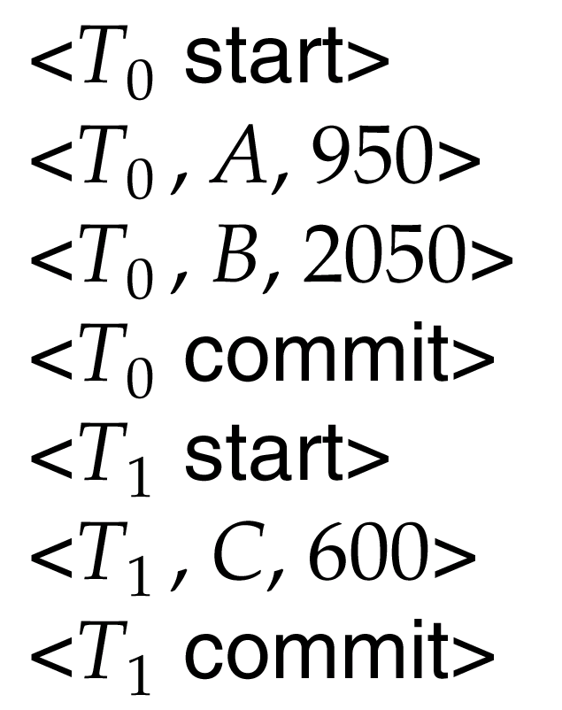
Portion of the Database Log Corresponding to T₀ and T₁

Slide 42
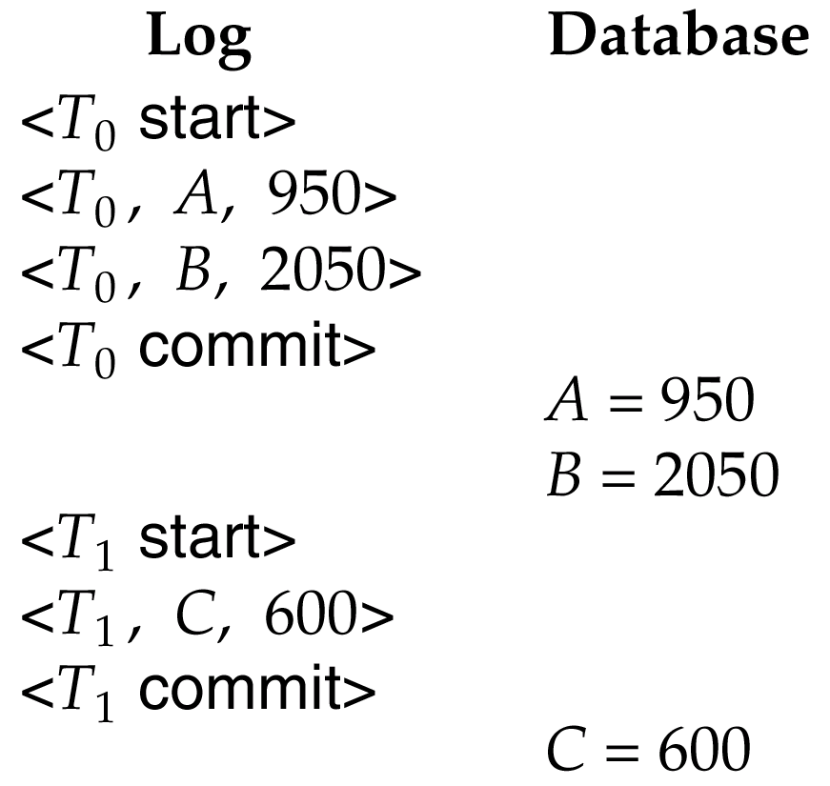
State of the Log and Database Corresponding to T₀ and T₁

Slide 43
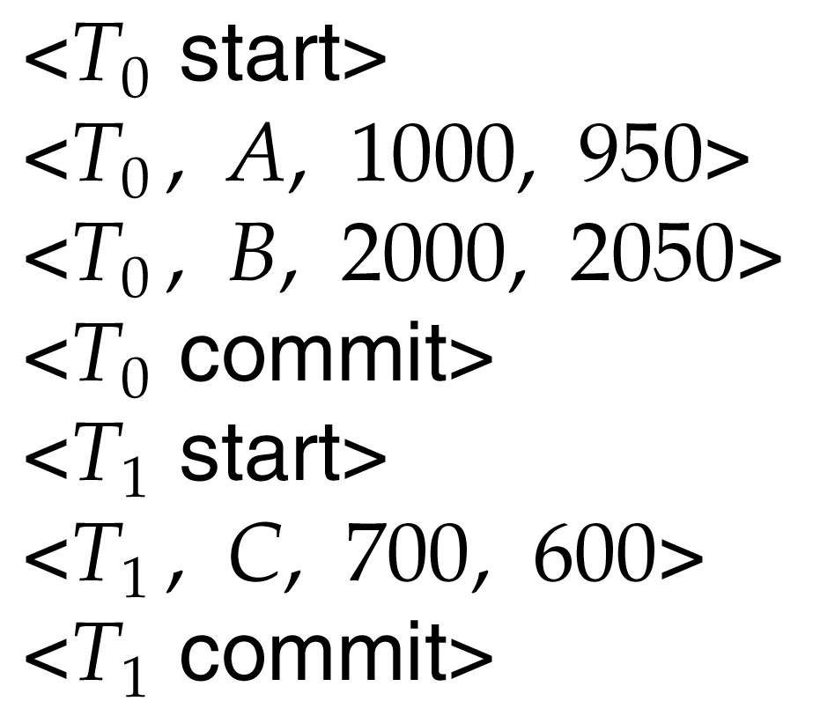
Portion of the System Log Corresponding to T₀ and T₁

Slide 44
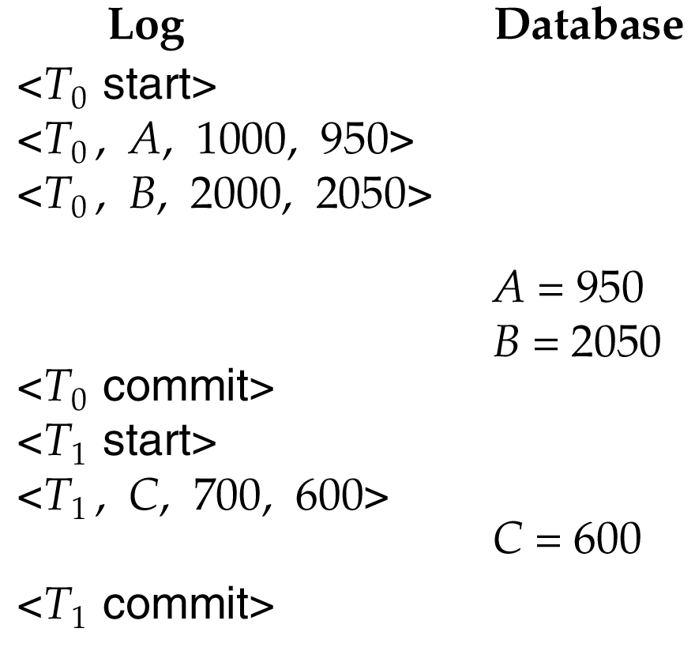
State of System Log and Database Corresponding to T₀ and T₁

Slide 45
Undo and Redo Operations
Undo of a log record <T_{i}, X, V₁, V₂> writes the old value V₁ to X
Redo of a log record <T_{i}, X, V₁, V₂> writes the new value V₂ to X
Undo and Redo of Transactions
undo(T_{i}) restores the value of all data items updated by T_{i} to their old values, going backwards from the last log record for T_{i}
Each time a data item X is restored to its old value V a special log record <T_{i} , X, V> is written out
When undo of a transaction is complete, a log record <T_{i} abort> is written out.
redo(T_{i}) sets the value of all data items updated by T_{i} to the new values, going forward from the first log record for T_{i}
No logging is done in this case

Slide 46
Recovering from Failure
When recovering after failure:
Transaction T_{i} needs to be undone if the log
contains the record <T_{i} start>,
but does not contain either the record <T_{i} commit> or <T_{i} abort>.
Transaction T_{i} needs to be redone if the log
contains the records <T_{i} start>
and contains the record <T_{i} commit> or <T_{i} abort>
Note that If transaction T_{i} was undone earlier and the <T_{i} abort> record written to the log, and then a failure occurs, on recovery from failure T_{i} is redone
such a redo redoes all the original actions including the steps that restored old values
Known as repeating history
Seems wasteful, but simplifies recovery greatly

Slide 47
Recovering from Failure
T₁ can be ignored (updates already output to disk due to checkpoint)
T₂ and T₃ redone.
T₄ undone

